Slide 1
Knuckles, The Robotic Arm
Andrew Blanchard, Matthew van Zuilekom, Rym Benchaabane, Paola Hernandez
Sponsored by MakerSpace
ECE 4335: ECE Systems Design
Faculty Advisor: Dr. Becker

Slide 2
Overall Project
What is Knuckles?
Assistive robotic arm that will hand the user requested objects and tools
Purpose
Increase the user’s productivity
Decrease the risk of dexterity incidents
Notes:
Knuckles: Assistive robotic arm that will hand the user requested objects and tools
Purpose: Assistant that will increase the user’s productivity and decrease the risk of dexterity incidents

Slide 3
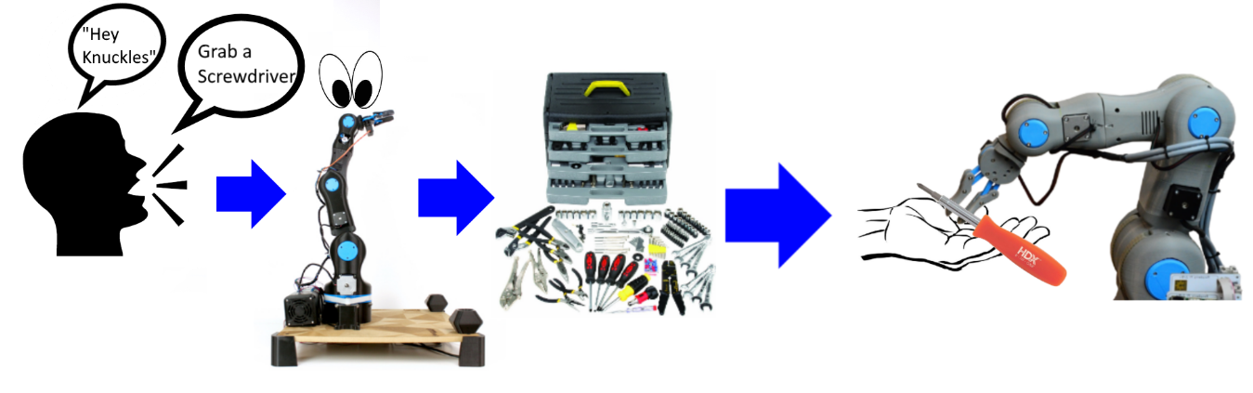
Overview Diagram
Notes:
Round corners

Slide 4
Deliverables
Fall 2018:
Physical arm and gripper prototype build
Hardware (Intel RealSense camera, multidirectional mic, tactile pads)
Simulation using Rviz on ROS
Text commands
Object recognition (75% done)
Manual control of arm and gripper (80% done)
Spring 2019 [ Mid-March ]
Complete software and automation
Voice commands
Object recognition
Fully built robot:
Tuned gripper and arm
For a fully functional robot!
Notes:
Replace image with reflection image

Slide 5
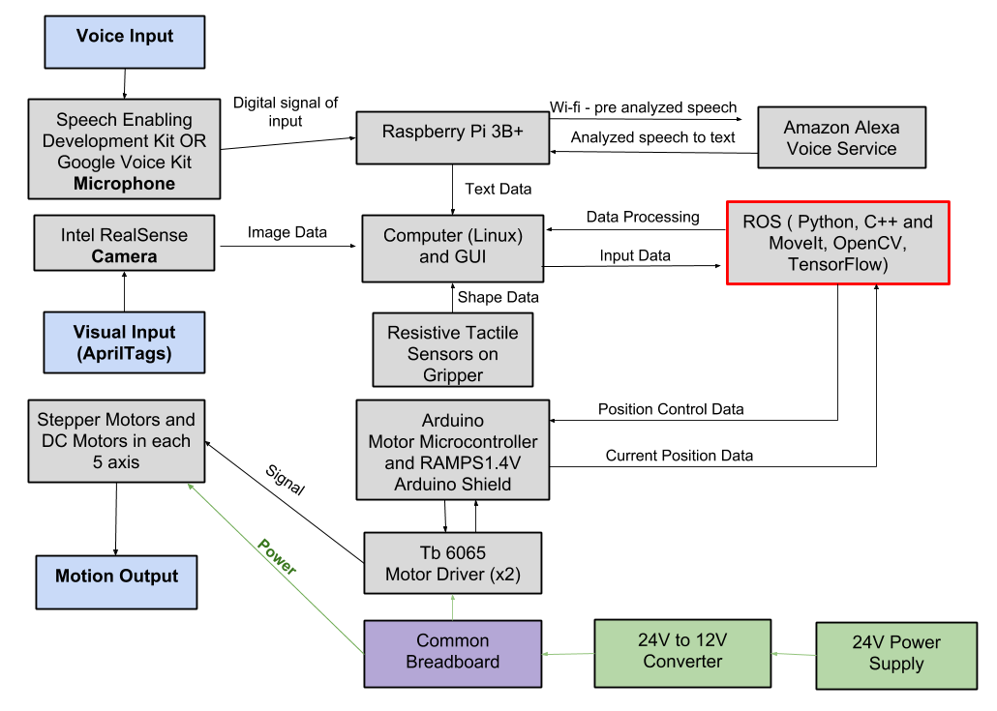
Design Considerations

Slide 6
Design Constraints
Time
Less time to optimize the gripper design to accommodate more shapes
Limited vision field
RealSense depth camera can’t see within one foot
Lift weight limitation

Slide 7
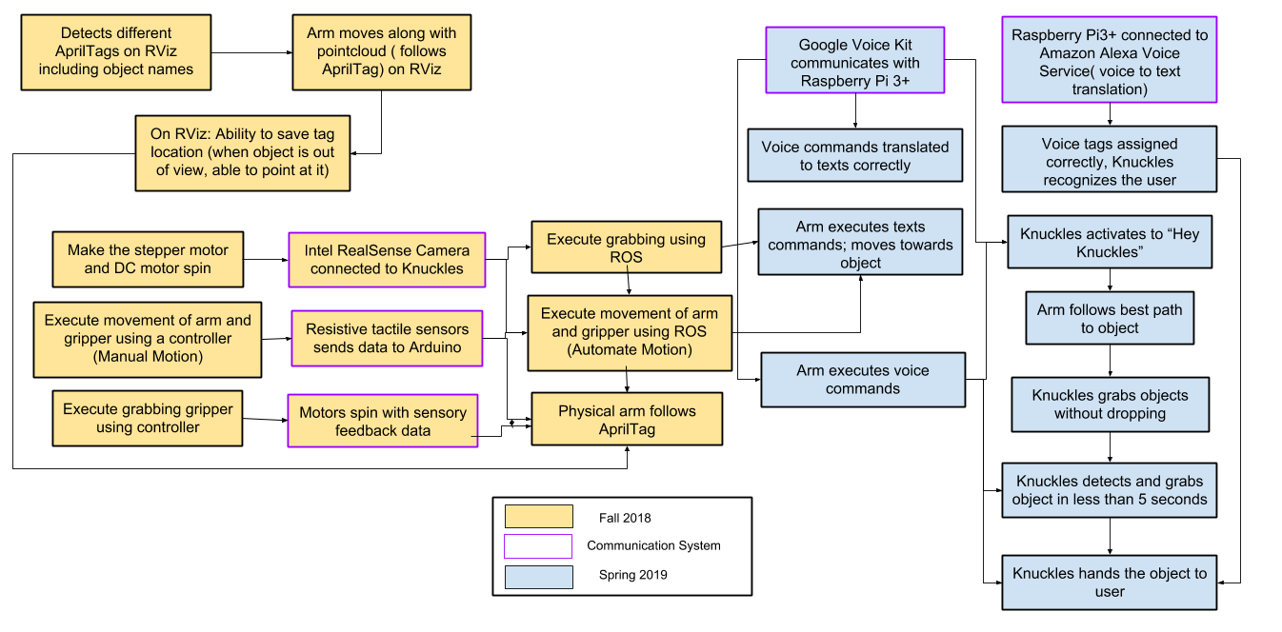
Target Objective - Goal Analysis

Slide 8
Test Plan & Schedule
November:
Robot is assembled and motors are spinning
Test the mobility of the robot: Verify the arm and gripper motion with a controller and when connected to ROS.
December:
Test the search function: Use text recognition to have the robot point at objects.
Test the retrieval function: Use text recognition to retrieve an object
Notes:
List test plan

Slide 9
Test Plan & Schedule
January:
Test the voice recognition: Compare voice commands to the text in the ROS terminal.
Test the gripper with the return: Robot presents user with object and waits until the user pulls on the object to let go.
February:
Last minute tuning
March:
2019 ECEDHA Conference in Tucson, Arizona
Notes:
Replace image with reflection image

Slide 10
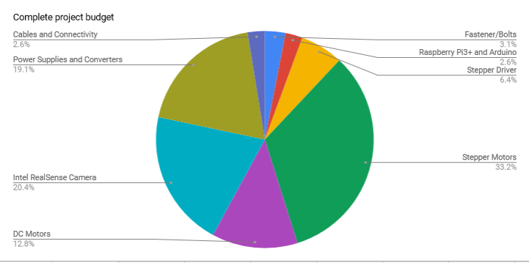
Budget
Total Budget : 1,800 $
Used 75%
The microphone choice is still TBA, looking for cheaper option
Notes:
Round corners

Slide 11
Project Conclusion
Schedule
Fall semester: most of the simulation and manual control
Spring Semester: implementation of software on Knuckles
Test plan
Modular plan will help us accomplish our goals
Current progress
Robot assembled and motors are spinning
Used 75% of budget
We are a little bit behind

Slide 12
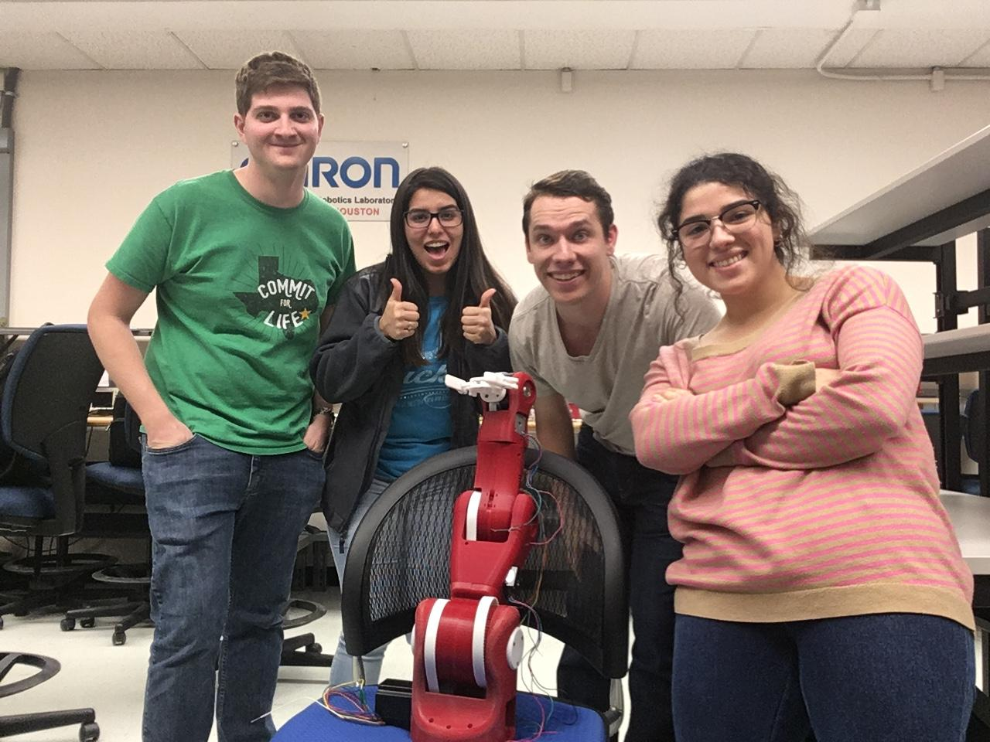
Thank you for your attention
QUESTIONS?

